Slide 1
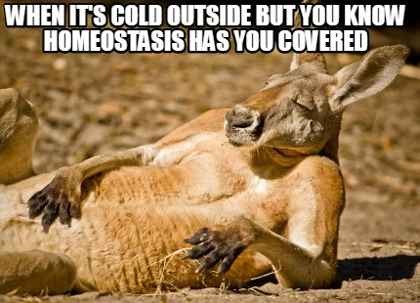
Date: | Human Biology Year 12 ATAR
Do Now Get out your stuff, ready to start! Lesson Agenda 1: Do Now 2: Intro to Homeostasis 3: Intro to Thermoregulation 4: Homeostasis when body temperature falls 4: Lesson summary and wind-up Suggested Study Complete review worksheet, mark and correct using answer key on Connect. Read through today’s notes and textbook section NEXT LESSON Past Exam Question Homeostasis when body temperature rises Disruptions to temperature homeostasis Fever | Learning Aims Define homeostasis and homeostatic mechanisms Describe the terms steady state and dynamic equilibrium Explain homeostatic set point and tolerance limits List and describe the key components of a homeostatic feedback loop (steady-state control model) Define negative and positive feedback, giving examples Define thermoregulation Describe mechanisms for heat loss and gain Identify locations of temperature receptors Identify control centres/modulators in thermoregulation Identify effectors in thermoregulation Outline responses when body temperature falls below set point Draw homeostatic feedback loops to represent thermoregulation when body temperature falls below the set point.
 | Key Vocabulary Homeostasis Steady State Control Model Homeostatic Feedback Loop Thermoregulation

Slide 2
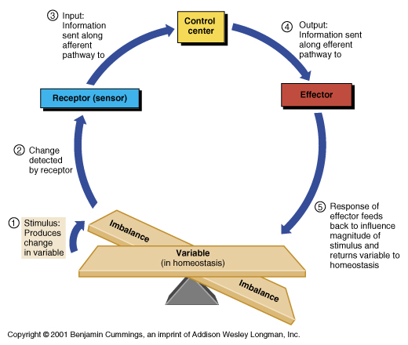
Homeostasis
Intro to Homeostasis
Ch 5 Human Perspectives

Slide 3
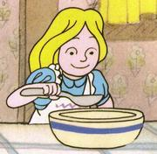
Homeostasis
Maintenance of internal body conditions within a narrow range of values – a “steady state”, so that organs and systems can continue to function.
Eg: Body temperature of 37ºC:
Allows chemical reactions within cells to proceed at the correct pace
“Not too hot, not too cold”
Allows proteins to maintain correct shape
Eg: Neutral fluid pH
Allows chemical reactions within cells to proceed at correct pace
Helps with management of CO₂ levels
Eg: Steady supply of glucose for cellular respiration
Eg: Steady supply of oxygen for cellular respiration
Learning Aim: Define homeostasis and homeostatic mechanisms

Slide 4
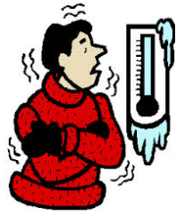
Homeostatic mechanisms
Are the mechanisms that maintain internal conditions
Allow some independence from external environment and therefore a survival advantage
Eg: mechanisms like increased metabolic rate, shivering, and changes to blood flow allow us to maintain body temperature even when it is cold outside.
Learning Aim: Define homeostasis and homeostatic mechanisms

Slide 5
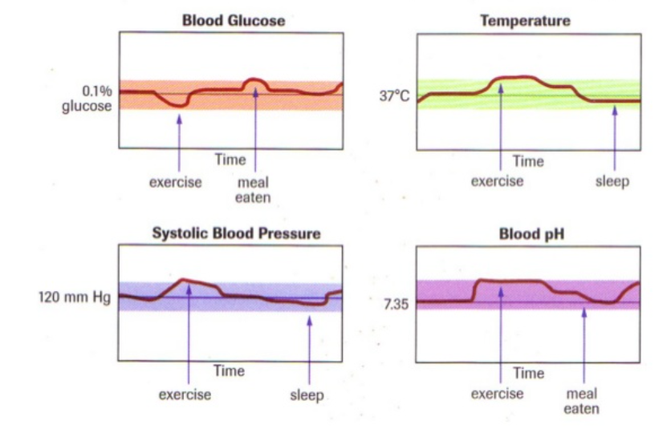
Steady State and Dynamic Equilibrium
Homeostasis maintains a “steady state” – a balanced internal environment in terms of:
Core body temperature
pH and concentration of other dissolved substances
Glucose concentration
O2 and CO2 concentration
Blood pressure
Metabolic waste concentration
Dynamic equilibrium:
The internal environment fluctuates within a narrow, acceptable range
There is a constant process of sensing, responding and feedback to maintain this.
Learning Aim: Define steady state and dynamic equilibrium

Slide 6
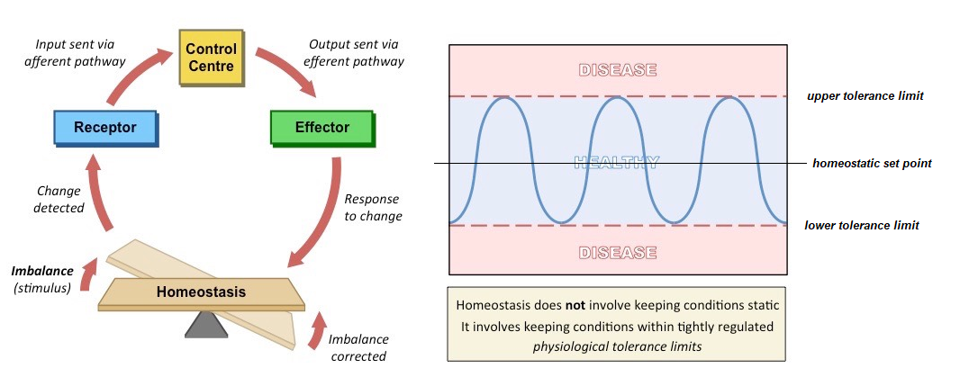
Tolerance limits:
The upper and lower limits of the factors in the body
Normal function within tolerance limits
Eg: the tolerance limits for blood glucose are 4.0-7.8mmol/L
If tolerance limits are breached (too high or too low), dysfunction will occur.
Learning Aim: Define homeostasis and homeostatic mechanisms

Slide 7
Homeostasis and Feedback Loops
Key Terms:
Stimulus: a change in the environment that can be detected and acted on.
Receptor: a part of the body that detects the change.
Message: how information is sent through the body.
Modulator (control centre): a part of the body that processes the information from the receptor, and sends information to the effector.
Effector: a part of the body that carries out the response to the stimulus, counteracting it and returning balance.
Response: how the effector responds to the message from the modulator
Feedback: achieved when the original stimulus has been changed by the response.
Learning Aim: List and describe the key components of a homeostatic feedback loop

Slide 8
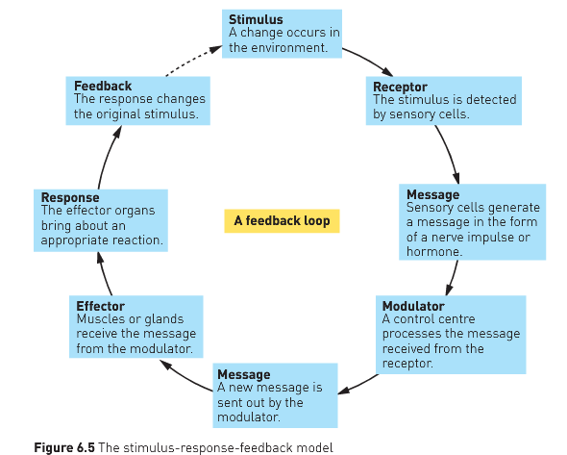
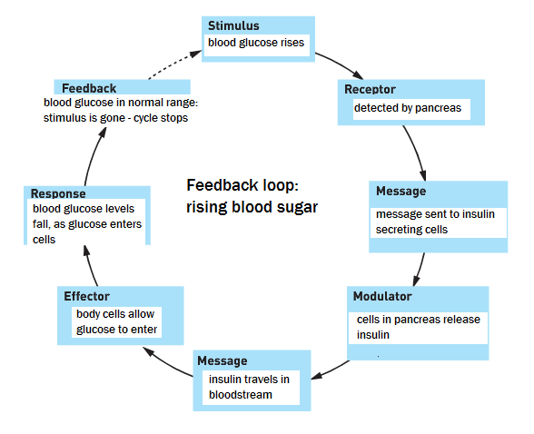
A homeostatic feedback loop
Learning Aim: List and describe the key components of a homeostatic feedback loop

Slide 9
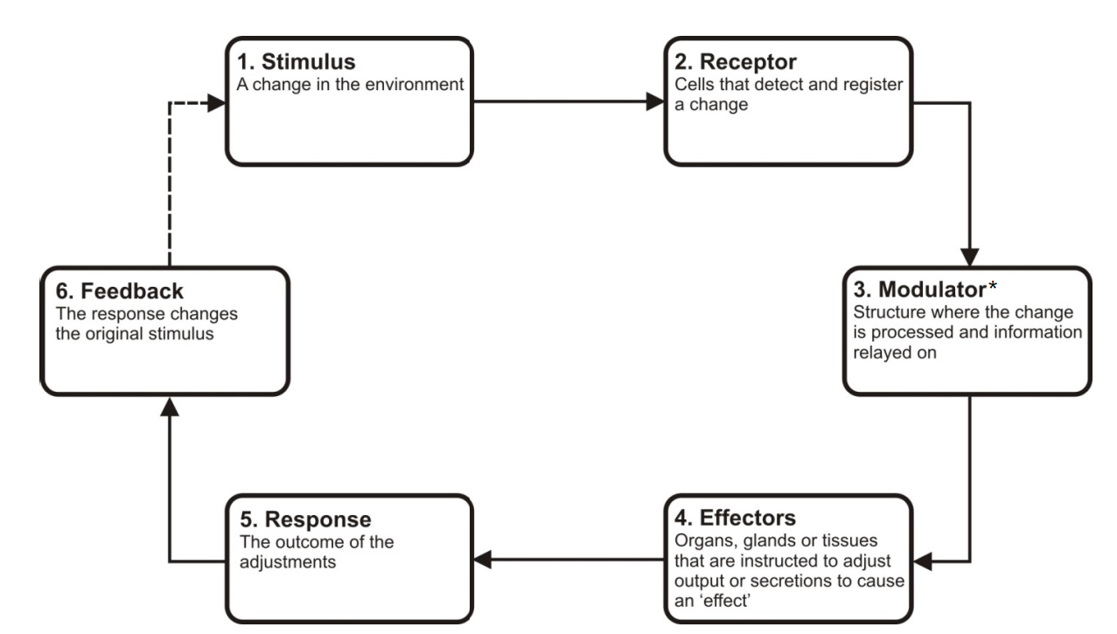
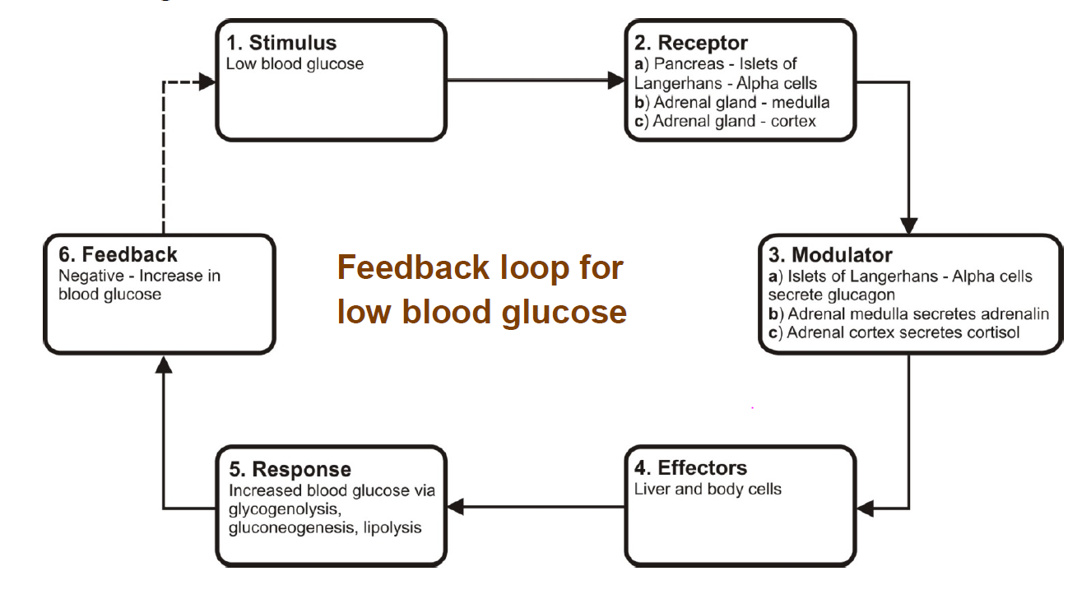
How to represent homeostatic loops in an exam question
A stimulus-response feedback model (steady state control model) is a good way of showing how mechanisms are operating in the body in order to maintain homeostasis.
Things to remember about this model:
• the loop represents a continuous process so there is no starting or finishing point
• the response alters the original stimulus
Learning Aim: List and describe the key components of a homeostatic feedback loop

Slide 10
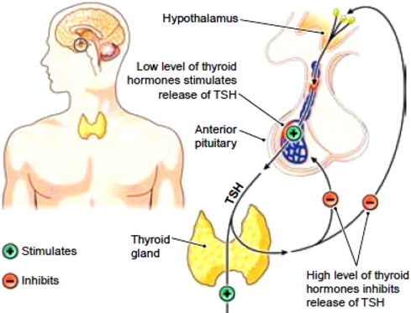
Feedback Systems
Negative feedback:
The response to the original stimulus reduces or eliminates the stimulus, and therefore the continued response.
Eg: Thyroid hormone negative feedback
Learning Aim: Describe positive and negative feedback, giving examples

Slide 11
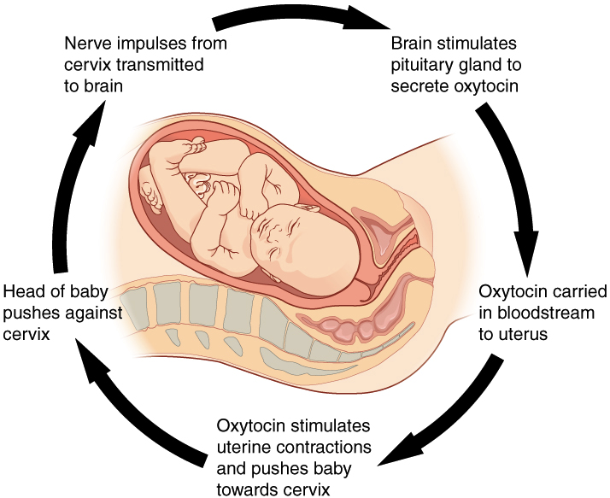
Feedback Systems
Positive feedback:
Occurs in processes where stimulus needs to be reinforced for continual effect: not usually part of homeostasis.
Examples: oxytocin release during labour
blood clotting cascade
Learning Aim: Describe positive and negative feedback, giving examples

Slide 12

Body Temperature Homeostasis
Intro to thermoregulation
Thermoregulation when body temperature falls
Chapter 5 Human Perspectives

Slide 13

Thermoregulation
Regulation of core body temperature at 37ºC set point
Temperature where chemical reactions in cells are stable and optimised.
Several homeostatic mechanisms involved.
Balance between heat production and heat loss.
If body temp is too high:
Proteins denature
Nerve cells do not function correctly
Chemical reactions are uncontrolled
DEATH
If body temp is too low:
Cellular reactions too slow
DEATH
Learning Aim: Define thermoregulation

Slide 14
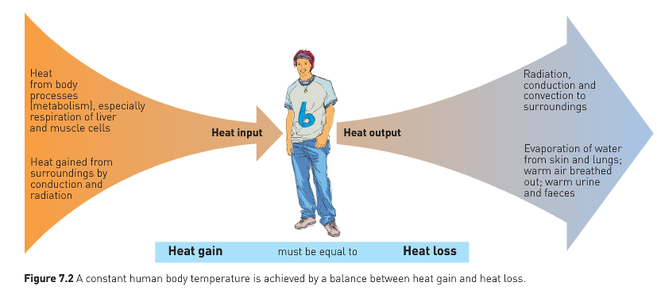
Homeostatic mechanisms balance heat gain and heat loss to maintain an internal temperature around the set point of 37ºC
Learning Aim: Describe mechanisms of heat loss and gain

Slide 15

External Heat gain
From external environment via conduction and radiation:
Conduction: warm air or water in contact with skin conducts heat into the body. Eg
Warm air from the heater in a warm room.
Warm water in a bath.
Warm air outside on a hot day.
Radiation: solar radiation when standing in the sun. Radiation from a heater.
Learning Aim: Describe mechanisms of heat loss and gain

Slide 16
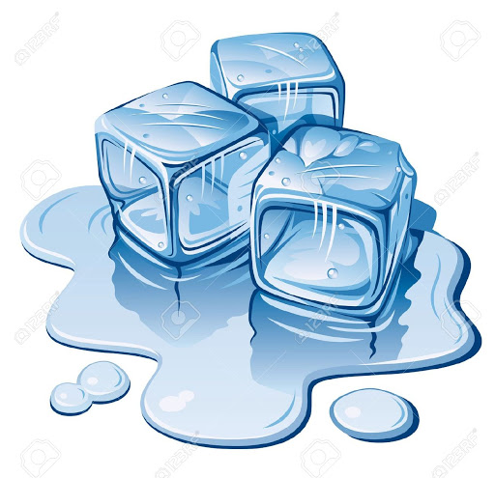
External Heat loss
From body via convection
Convection: cold air or water in contact with skin moves heat away from the body. Eg
Cold air outside or in a cold room
Cold wind moves heat very quickly away from skin
Cold water in a bath or swimming pool
Sweat evaporates from skin,taking heat away from the skin
Learning Aim: Describe mechanisms of heat loss and gain

Slide 17
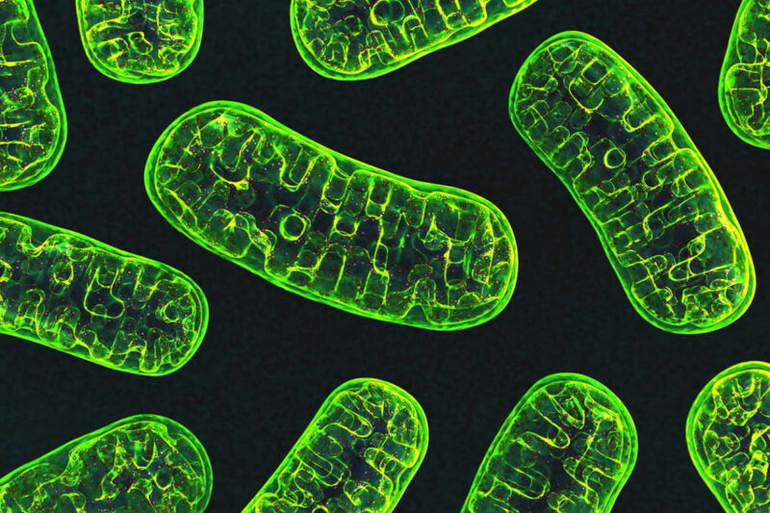
Internal Heat Gain
During cellular respiration (metabolism)
When metabolic rate increases, heat production increases.
Eg during Exercise:
Muscles need energy to contract
Cells respire more
More heat produced
Body heat rises
Things that can increase metabolic rate and body heat include:
Exercise
Stress
Sympathetic NS stimulation
Learning Aim: Describe mechanisms of heat loss and gain

Slide 18
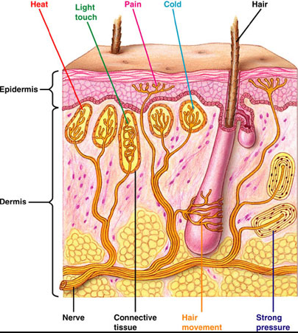
Temperature Receptors (thermoreceptors)
Peripheral thermoreceptors:
In skin and other surface tissues
Detect temperature of external environment
Cold receptors
Heat receptors
Send signals to hypothalamus, which then acts to regulate body temperature
Central thermoreceptors
In hypothalamus, spinal cord, abdominal organs
Send signals to hypothalamus, which then acts to regulate body temperature
Learning Aim: Identify locations and types of thermoreceptors involved in thermoregulation

Slide 19
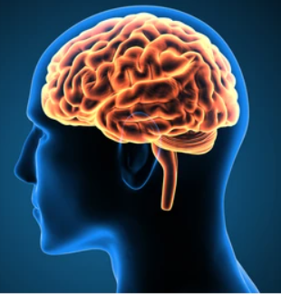
Control Centres/Modulators for Thermoregulation
Two main Control Centres/Modulators for Thermoregulation
1: The Hypothalamus
Receives input from thermoreceptors in skin, and also its own thermoreceptors
Send messages to effectors to regulate temperature
2: The Cerebral Cortex
Receives input from thermoreceptors in skin and hypothalamus
Integrates conscious awareness of body temperature
Coordinates effectors to regulate temperature
Learning Aim: Identify modulators/control centres involved in thermoregulation

Slide 20
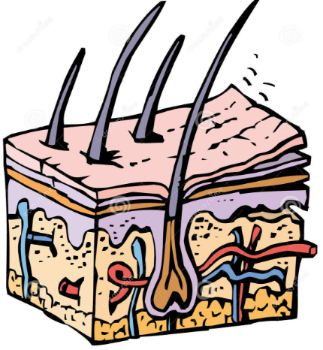
Effectors in Thermoregulation:
Skin provides large surface area for heat exchange via
Conduction
Convection
Radiation
Blood vessels help exchange heat between external and internal environments
Diameter of blood vessels can be controlled to increase or decrease this exchange
Sweat glands in skin produce sweat when body is too hot
Evaporative cooling!
Note: evaporation from lungs also causes heat loss
Muscle activity can be used to generate heat
Endocrine glands can produce hormones that effect metabolism and therefore heat gain from cellular respiration
Learning Aim: Identify effectors involved in thermoregulation

Slide 21
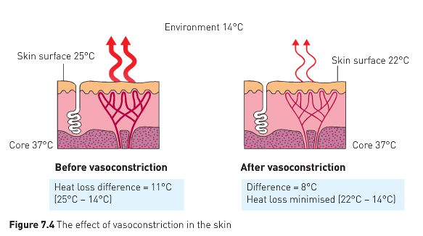
Responses when body temperature falls below set point
Vasoconstriction
Autonomic (sympathetic) stimulation from hypothalamus causes blood vessels to constrict.
Decreases flow of warm blood to skin, so less loss to cold environment via conduction, convection and radiation.
Decreased Sweating
Autonomic stimulation from hypothalamus decreases sweat production, decreasing evaporative cooling
Learning Aim: Describe responses when body temperature falls below set point.

Slide 22
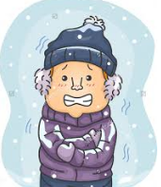
Responses when body temperature falls below set point
Shivering
Hypothalamus sends message to brain centres that control skeletal muscle tone
Results in shivering – quick, repeated contraction of muscles, requiring cellular respiration.
Heat is released from muscles as a by-product of cellular respiration
Can be influenced by conscious thought from cerebral cortex (up to a point)
Learning Aim: Describe responses when body temperature falls below set point.

Slide 23
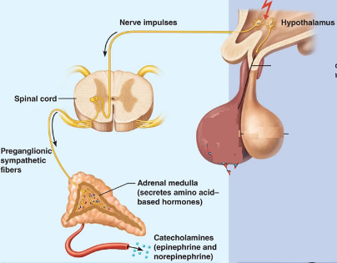
Responses when body temperature falls below set point
Hypothalamic Sympathetic NS stimulation of adrenal medulla – endocrine response.
Adrenalin and Noradrenalin release.
Increase in cellular metabolism and heat production.
Counteracts heat loss.
Learning Aim: Describe responses when body temperature falls below set point.

Slide 24
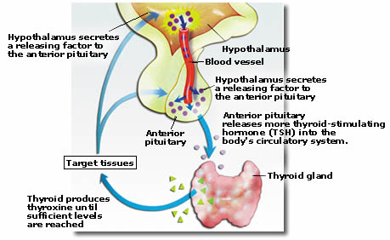
Responses when body temperature falls below set point
Increase in thyroxine production
Hypothalamus sends message to anterior pituitary for endocrine response
TSH (Thyroid Stimulating Hormone) released
Stimulates Thyroid
Thyroxine released
Increases metabolic rate and therefore heat.
Learning Aim: Describe responses when body temperature falls below set point.

Slide 25
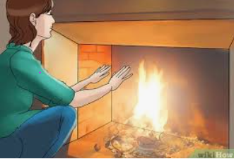
Responses when body temperature falls below set point
Conscious and behavioural responses to heat loss:
Conscious awareness of feeling cold leads to behavioural changes to minimise heat loss:
Seeking shelter from wind/rain/cold weather, and seeking warmth
Putting on clothing to insulate against heat loss
Curling up to decrease surface area for heat loss
Moving more to increase metabolic activity to increase heat gain
Learning Aim: Describe responses when body temperature falls below set point.

Slide 26
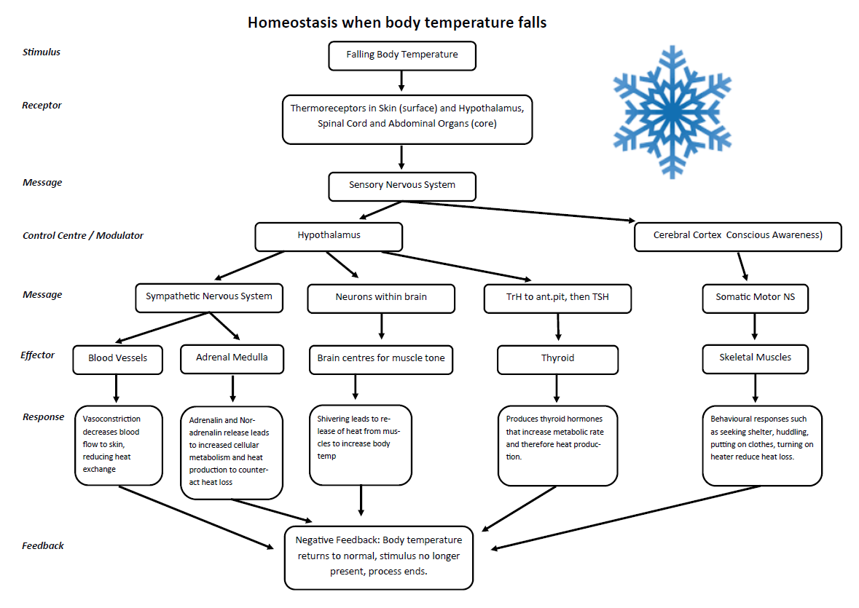

Slide 27
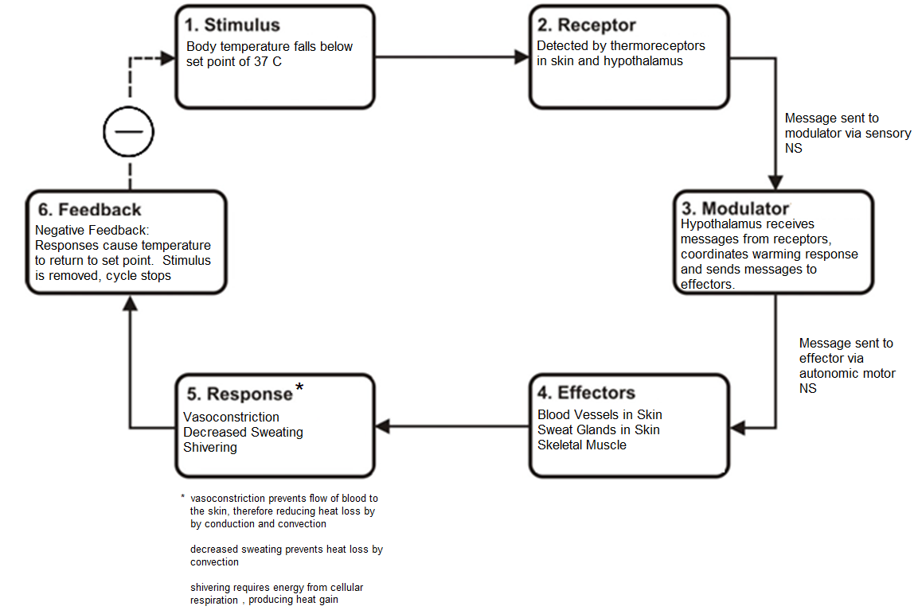
Example of homeostatic feedback loop:
Autonomic regulation of falling body temperature
Note: you will need to be able to do feedback loops for all of the different ways body temperature is regulated – you can practice this on your review worksheet.
Learning Aim: Draw homeostatic feedback loops (steady state control models) to represent thermoregulation when body temperature falls.

